Slide 1
Remote Camera Security
Xander Carroll, Jacob Hatef
Notes:
Our project involved breaking into cameras. This is hacking like you’ve seen it in the movies - hacking like your parents ask you about when you tell them that you are studying cybersecurity.
(~30s)

Slide 2
Internet Of Things (IoT)
Definition: Traditionally dumb devices that have been embedded with technology that allows them to communicate with the internet ^{[1]}
Definition: Cheap, dumb, devices that have been connected to the internet
Definition: Very vulnerable devices that we are connecting to the internet
Notes:
Specifically, we tried to hack IOT cameras. So it will be helpful to define what an IOT device is.
This was the first definition I came across, when I googled:
“Traditionally dumb devices that have been embedded with technology that allows them to communicate with the internet.”
I would rewrite this as: Cheap and dumb devices that someone let be connected to the internet. Devices that did not prioritize security.
So we can actually rewrite that as: Very vulnerable devices that we are connecting to the internet for some reason.
(~60s)

Slide 3
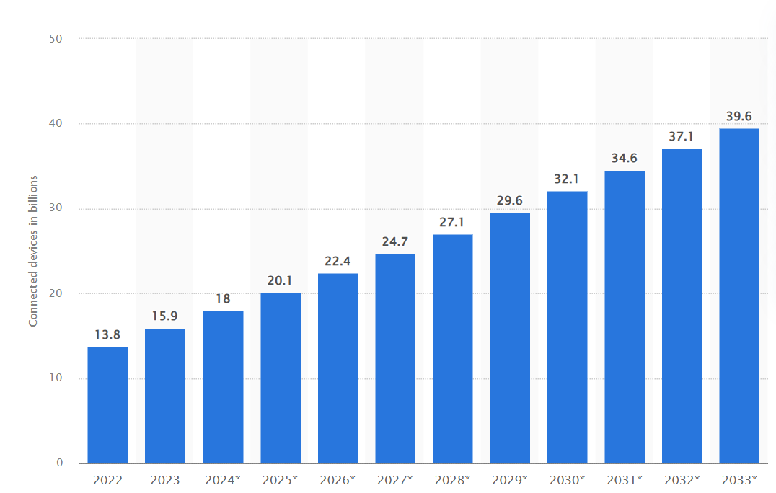
Motivation
Internet of Things (IoT) devices are becoming more and more popular ^{[2]}
Need for increased security of connected IoT devices, particularly those with sensitive information like video feeds
Image Source: [2]
Notes:
(~30s)

Slide 4
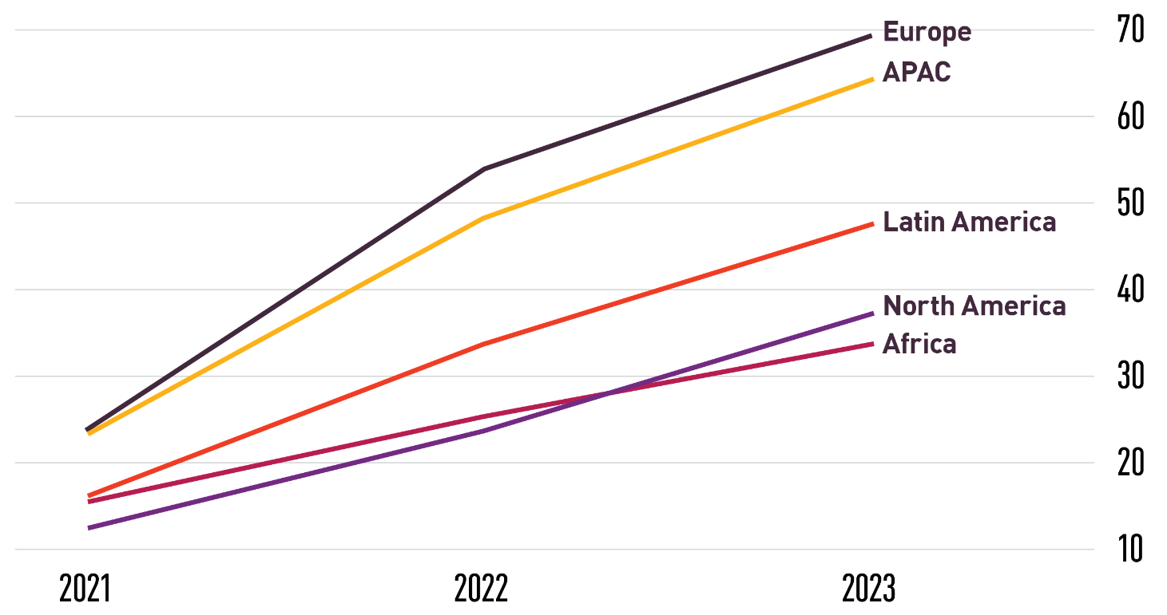
Motivation
Internet of Things (IoT) attacks are becoming more and more prominent
Average number of IoT attacks per organization on a weekly basis:
Image Source: [3]
Notes:
(~30s)

Slide 5
Our Technical Contribution
A toolset of basic scripts
 | Scans a network
 | Checks devices for known vulnerabilities
 | Reports the results
Notes:
To secure devices, we need to know if they are vulnerable. So we designed a toolset that will scan a network, targeting IOT cameras with known vulnerabilities.
Our contribution heavily utilizes nmap, but is simple enough that it is not an extension of any other software.
(~30s)

Slide 6
Related Work
There are other tools that can map network vulnerabilities
We are curating a tool specifically for IoT cameras and associated vulnerabilities
We want users to be able to recognize and fix vulnerable cameras that they may use in their homes
nmap
Qualysguard
Nessus
OpenVAS
Shodan
Wireshark
Notes:
(~60s)

Slide 7
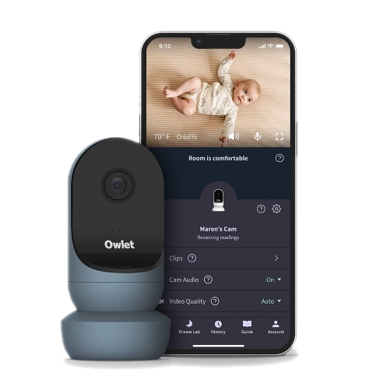
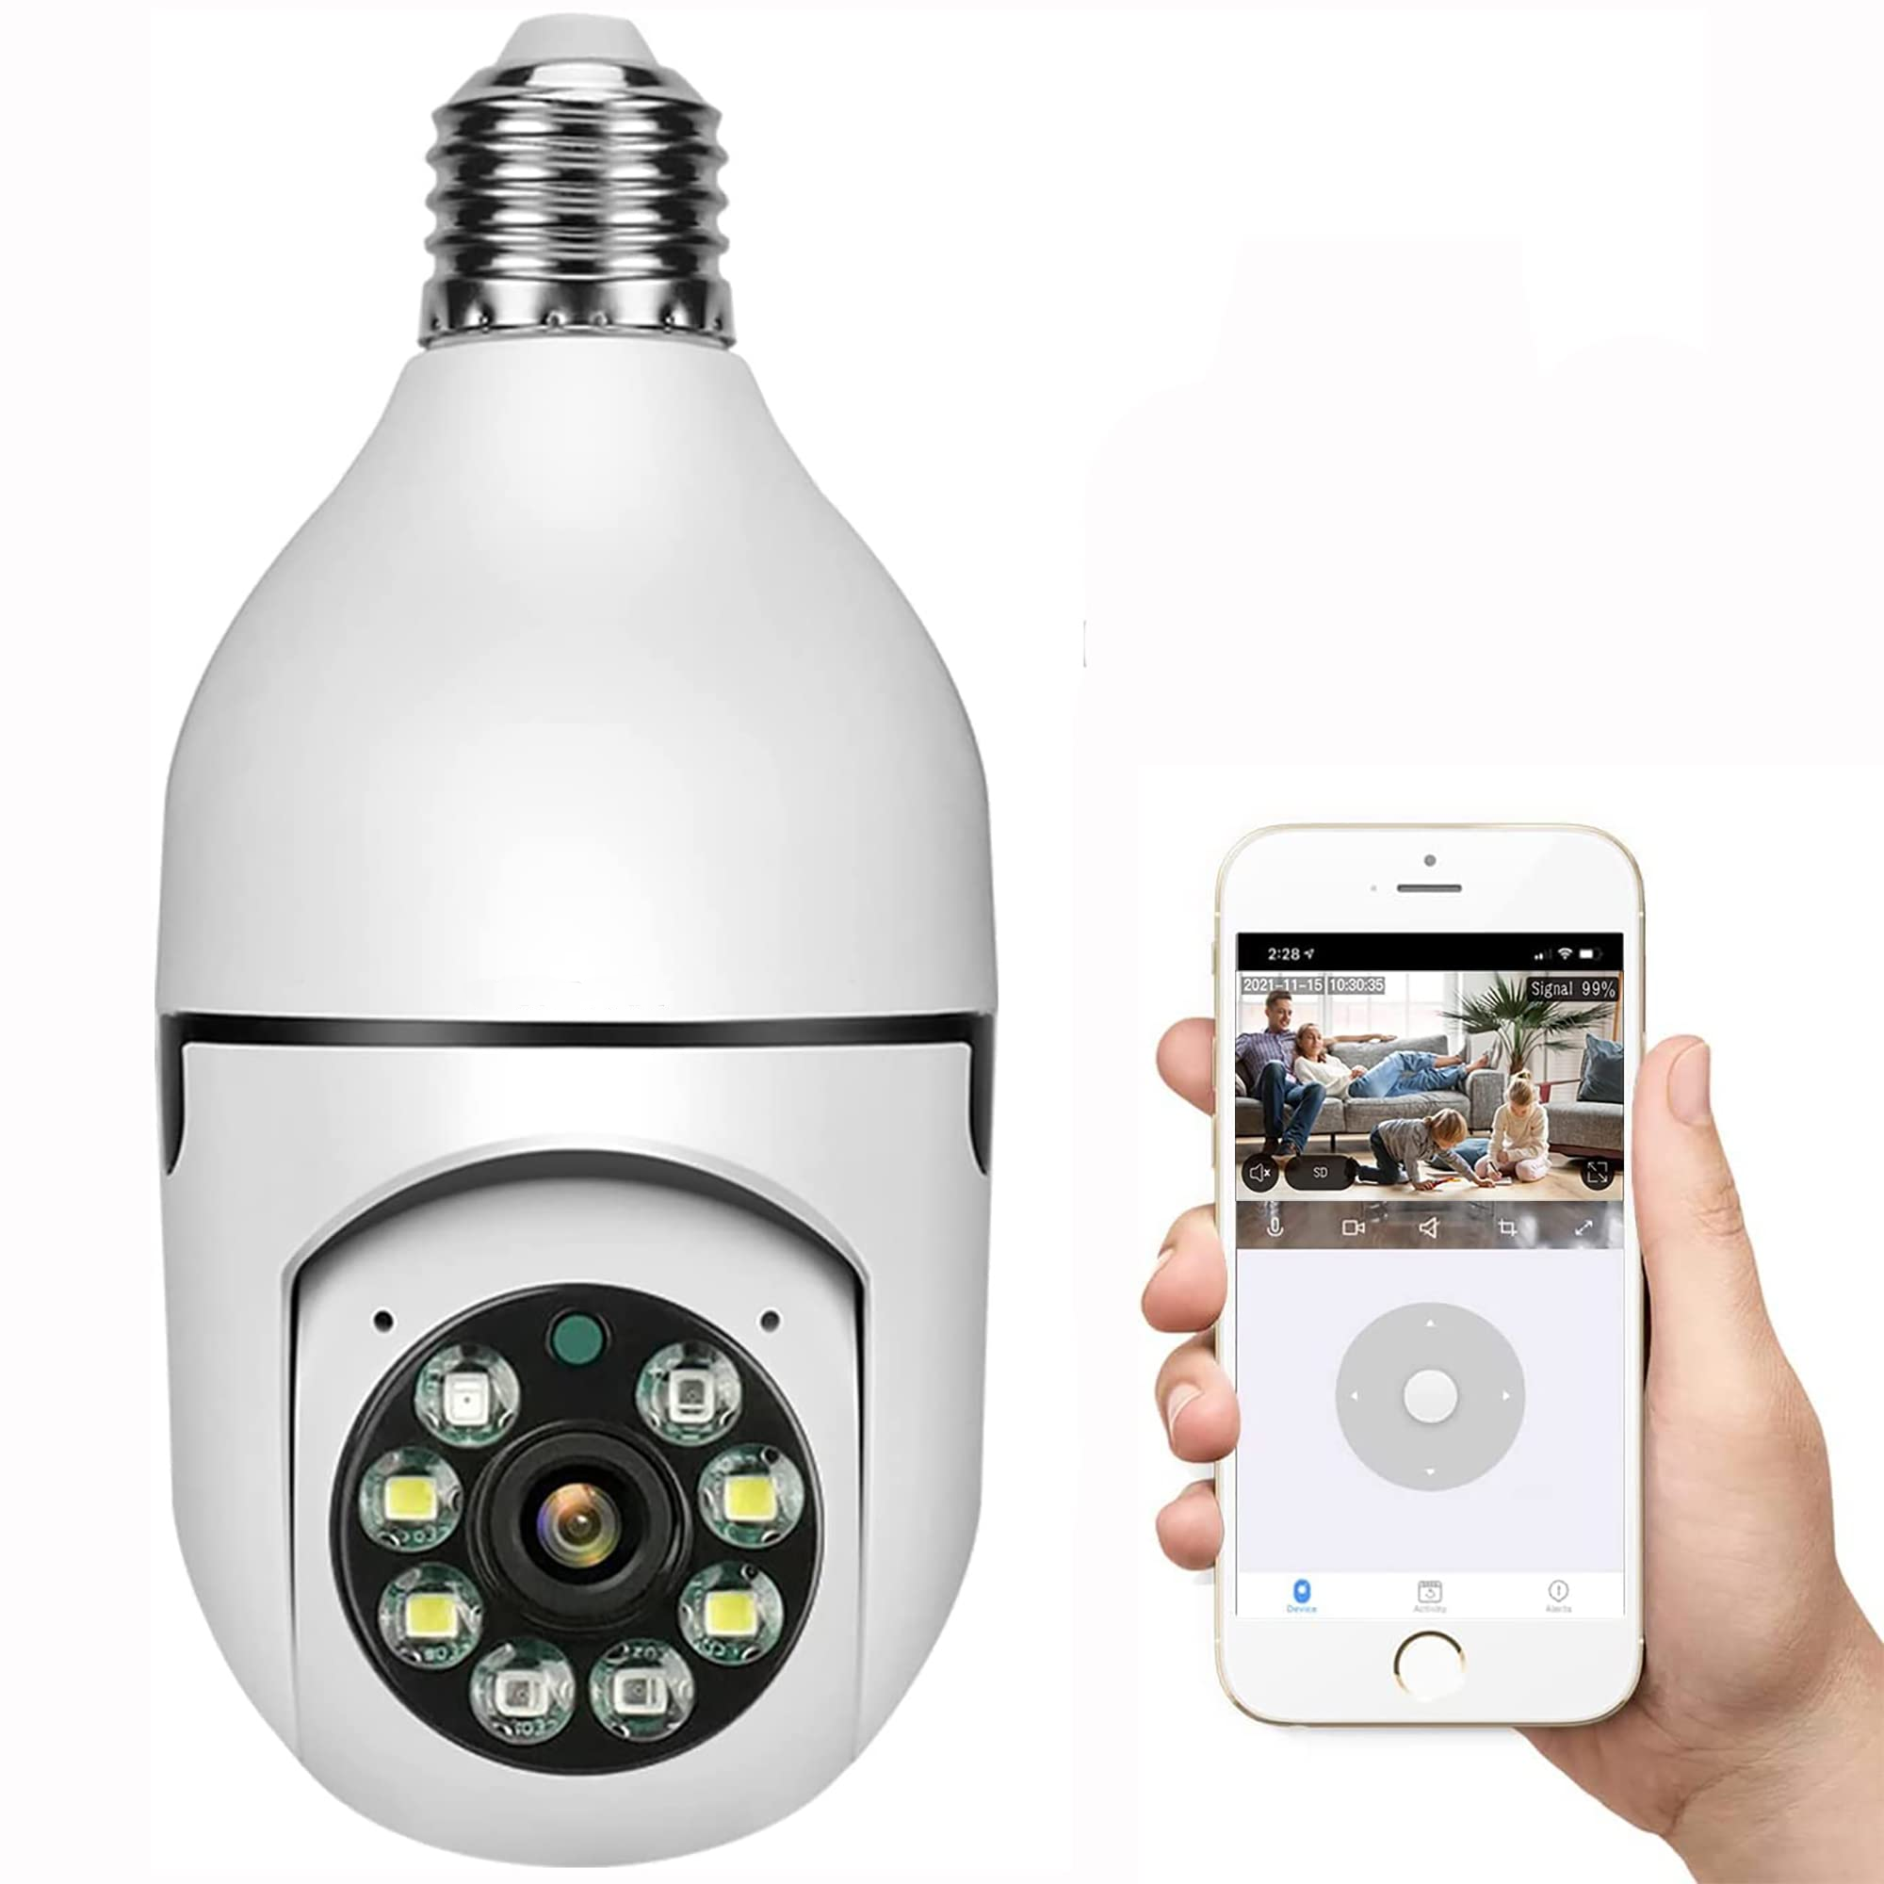
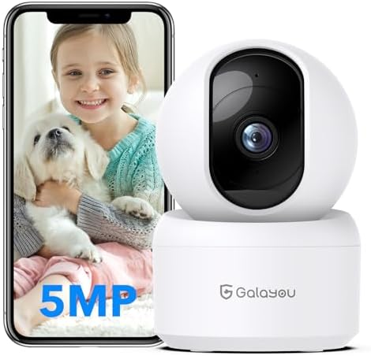
Finding Vulnerabilities
Owlet Camera ($100)
Galayou G2 ($17)
Unnamed WiFi Camera ($7)
Image Sources: [4], [5], [6]
Notes:
The difficulty here was finding those known vulnerabilities.
I spent months trying to break into an Owlet camera that I borrowed from my sister. It had a report detailing it’s weaknesses, but I couldn’t reproduce the attack.
But then I remembered my definition of an IOT device. My definition says that IOT devices are cheap. So clearly the problem isn’t me - we just aren’t cheap enough yet.
Cut that price down - and suddenly we started finding easy vulnerabilities.
(~45s)

Slide 8
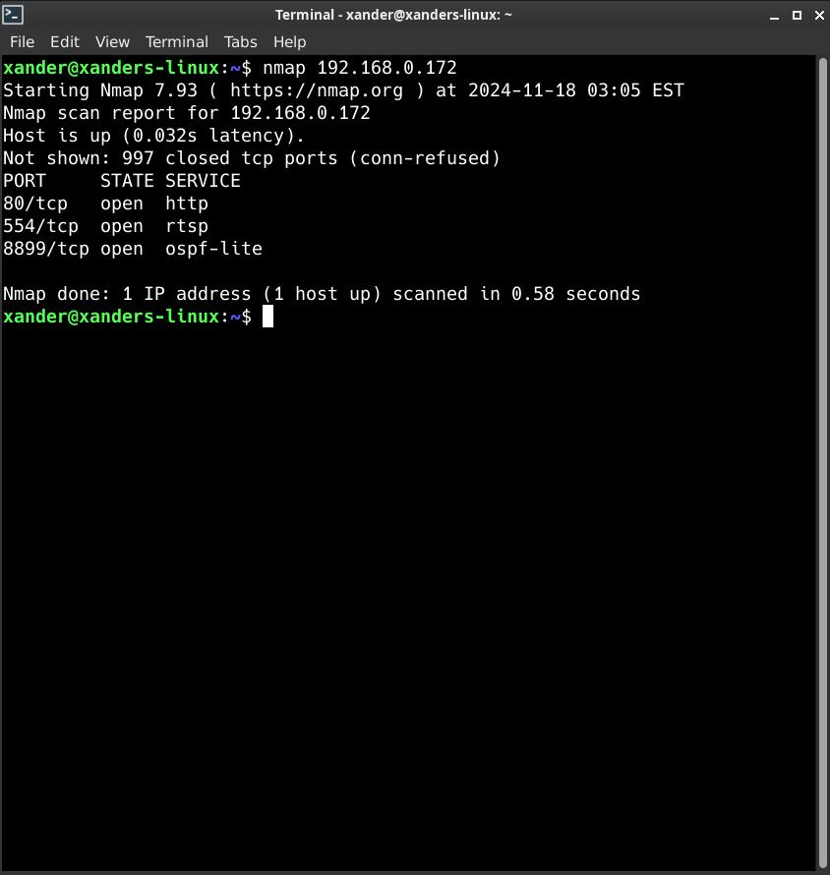
Finding Vulnerabilities
01
02
nmap
Exploit
Scan the device for open ports.
Find vulnerable services.
Notes:
And how do we do that - two steps.
We use nmap to see what ports the device is leaving open.
And then we exploit the vulnerabilities on those ports. (Or if there aren’t vulnerabilities we find a cheaper device).
(~15s)

Slide 9
Attacks
1
RTSP Brute Force
“Real Time Streaming Protocol”
Default Port 554
Often has weak passwords
Can be viewed with VLC
rtsp://username:password@ip:port/path
Notes:
Let’s talk about some of these attacks. The first is an RTSP attack.
The RTSP protocol takes a username and password to stream a video over a network.
Most of these cheap devices have a weak default password, or in the case of the Galayou, a backdoor username and password.
(~15s)

Slide 10
Attacks
2
FTP Brute Force
“File Transfer Protocol”
Default Port 21
Often has weak passwords
Can be accessed with a file explorer
ftp://username:password@ip:port/path
Notes:
The second attack is an FTP brute force.
The FTP protocol takes a username and password to share files over a network.
Most of these cheap devices have a weak default password, or in the case of my camera, no password.
(~15s)

Slide 11
Attacks
3
SSH Brute Force
“Secure Shell”
Default Port 22
Often has weak passwords
Can be accessed with a terminal
ssh username@ip
Notes:
And the third attack is an SSH brute force.
The username and password can again be weak.
(~15s)

Slide 12
Demo
1
RTSP Brute Force
2
FTP Brute Force
Notes:
(~2 min)

Slide 13
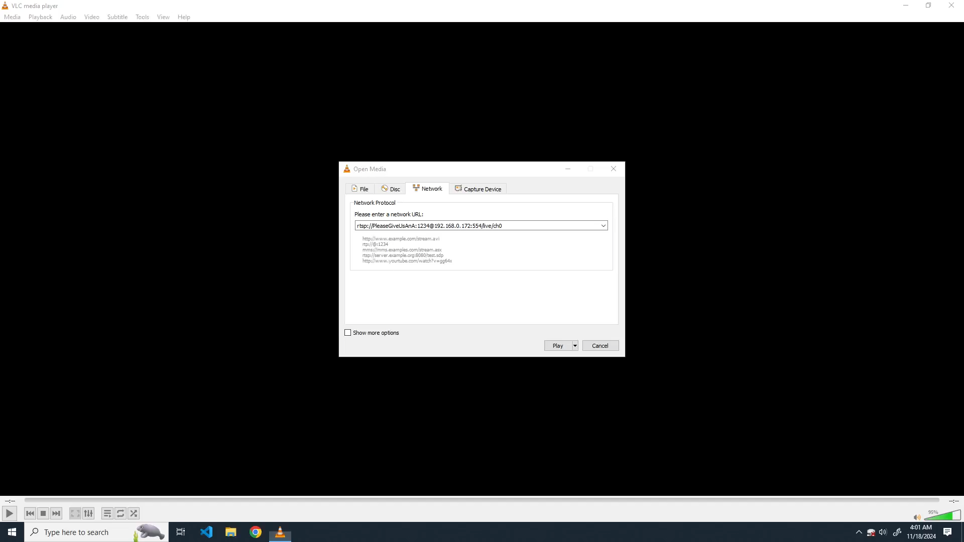
Notes:
Here the login is supposed to be “PleaseGiveUsAnA:1234” but there is a backdoor login of “admin:galayou” regardless of what password the user sets.

Slide 14
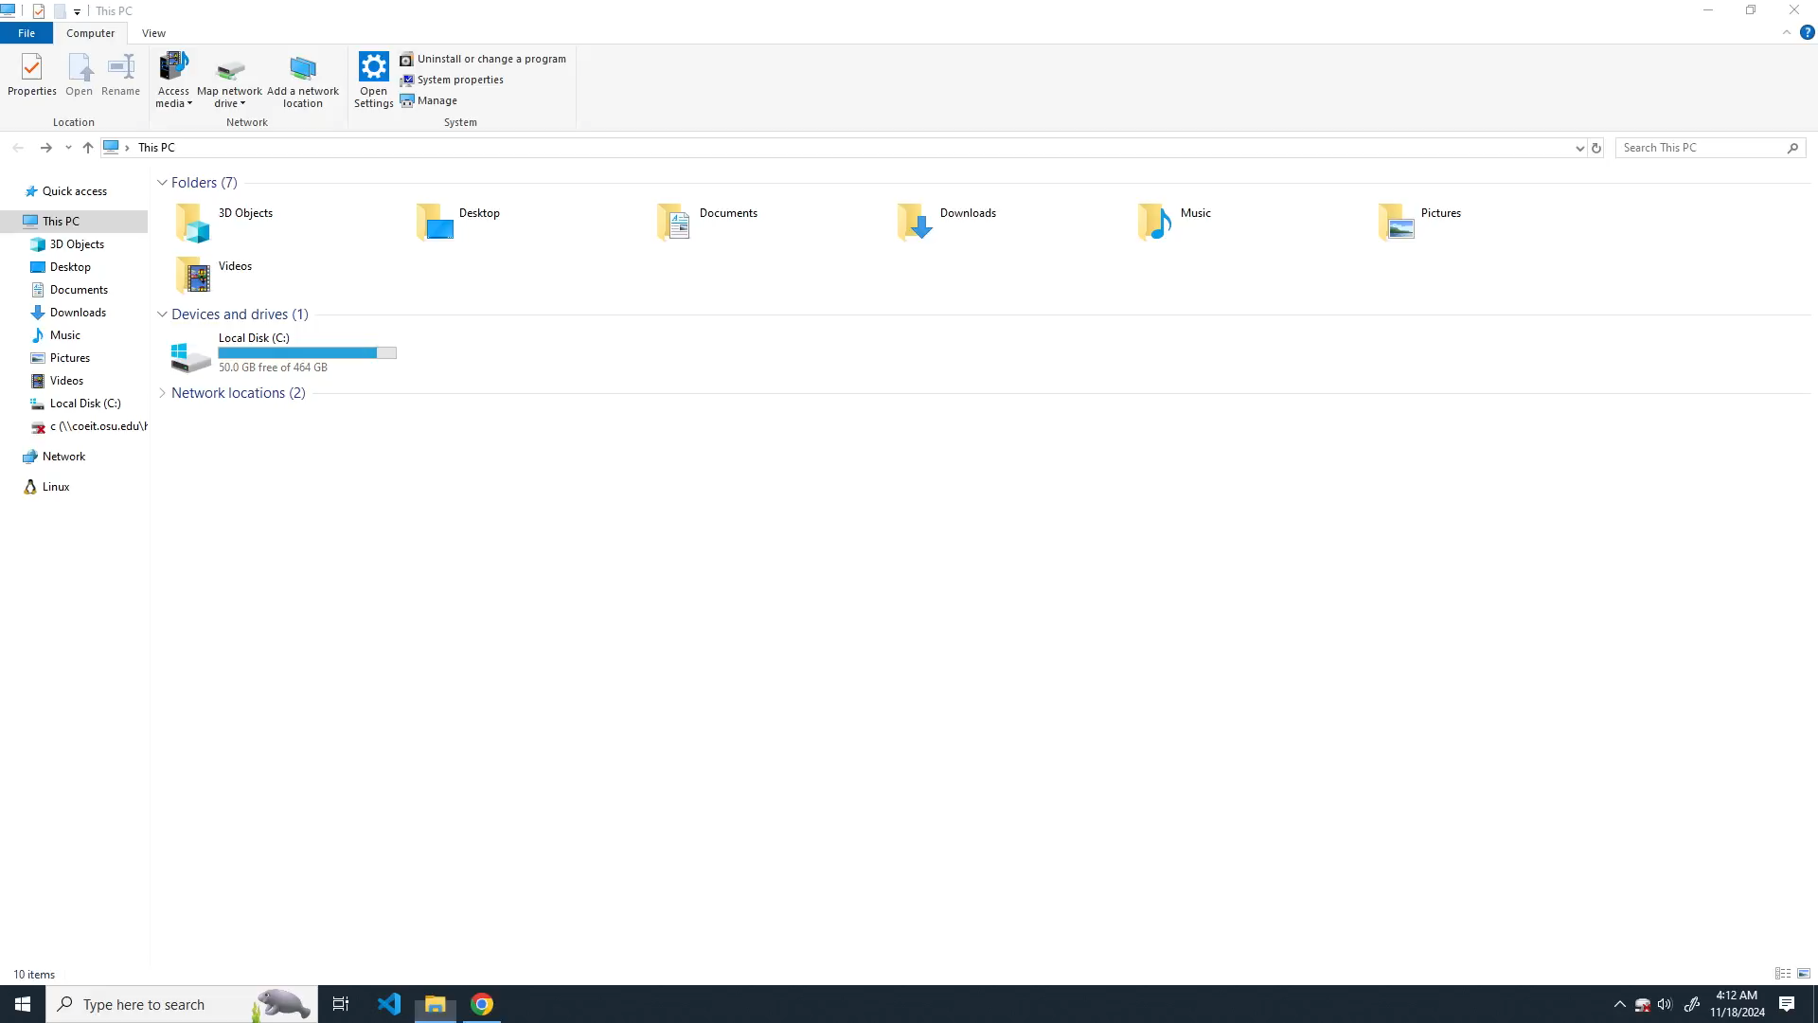
Notes:
Here there is no login required to use FTP. Logging in as root gives you complete access to the filesystem where you could even flash custom firmware to the camera gaining complete control over it.
But that is what you get with a $7 camera.

Slide 15
Evaluation
Starting scan at 2024-11-18 02:07:31
scan report for 192.168.0.0/24
192.168.0.172
PORT SERVICE ATTACK
80 http -
554 rtsp VULNERABLE
8899 ospf-lite -
192.168.0.209
PORT SERVICE ATTACK
80 http -
554 rtsp VULNERABLE
8899 ospf-lite -
192.168.0.197
PORT SERVICE ATTACK
21 ftp VULNERABLE
6789 ibm-db2-admin -
192.168.0.196
PORT SERVICE ATTACK
135 msrpc -
139 netbios-ssn -
445 microsoft-ds -
5357 wsdapi -
The results of the attacks are summarized in a report
An example is shown
Presents metrics for a local network (networks with few devices)
If the same network is scanned, the results are consistent
Notes:
We compiled the previous attacks into an automated script that will report on the vulnerability status of the network in a way that is very similar to nmap.
The example shows four devices connected to a network, three of which have vulnerabilities. The first two have the RTSP vulnerability, and the third has an FTP vulnerability.
The report shows metrics for a local network, but small networks mean fewer data points. We will talk about the wider internet’s vulnerability later.
And this report is consistent. If the scan is run more than once with the same network configuration, it will generate the same results.
(~60s)

Slide 16
Evaluation and Conclusion
Easy To Interpret Results
We found vulnerabilities
Number Of Vulnerabilities
My network had 3 vulnerabilities, but the wider internet will have more
Cheap Devices
Consumers are using devices that do not prioritize security
Notes:
These results are easy to interpret, there isn’t any ambiguity, we found vulnerabilities.
My network had three exploitable devices, but we will see that the wider internet has many, many more.
And this relates back to our design and motivation, consumers keep using cheap devices, so we need to help find common exploits.
(~60s)

Slide 17
Lessons, Problems, and Future Work
More Attacks
Many Devices
Minimal Docs
There are many more vulnerabilities to find
Some devices are more secure than others
Net securty is its own field.
Attacks are hard to find.
FUTURE
PROBLEM
LESSON
Notes:
In the future we can always make more attacks. The problem with this is that there are so many devices, and some are just more secure than others.
(~60s)

Slide 18
Shodan.io
Our tool scans a local network, but these vulnerabilities also exist on the internet
A tool like Shodan.io can be used to find them
24,689 potentially vulnerable cameras
9,788 do not have a password
Notes:
It is worth mentioning that these vulnerabilities don’t just exist on local networks.
We can use Shodan.io to find thousands of potentially unsecured cameras. Some of those are even in Ohio.
(~30s)

Slide 19
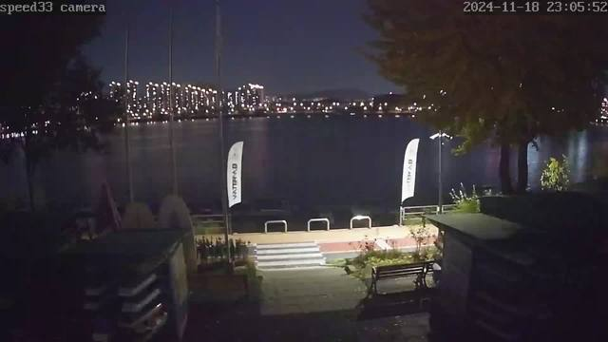

South Korea
Republic of Seoul
Notes:
Shodan.io Demo
(~60s)

Slide 20
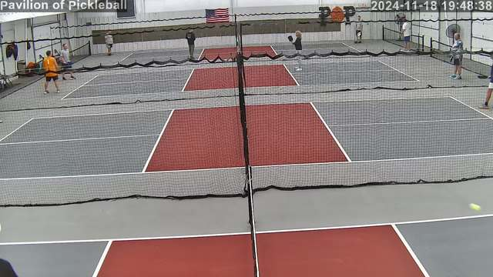

United States
Chicago, IL
Notes:
Shodan.io Demo
(~60s)

Slide 21
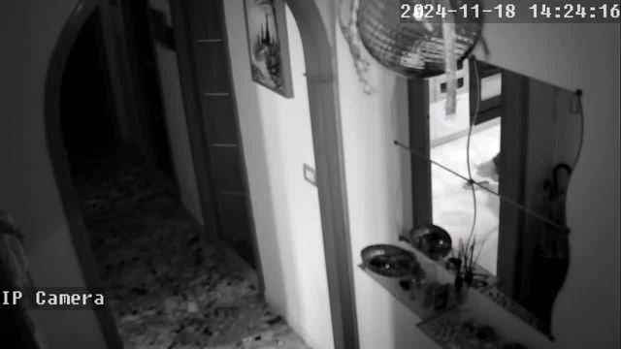

Italy
Naples
Notes:
Shodan.io Demo
(~60s)

Slide 22
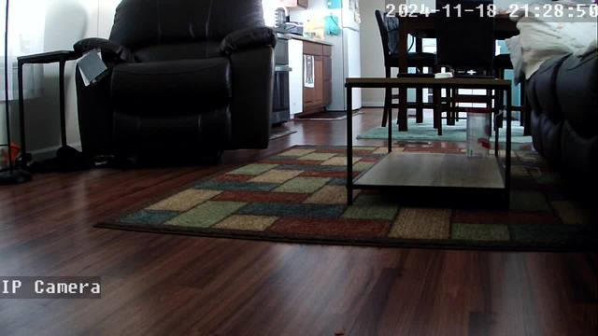
United States
Garner, NC
Notes:
Shodan.io Demo
(~60s)

Slide 23
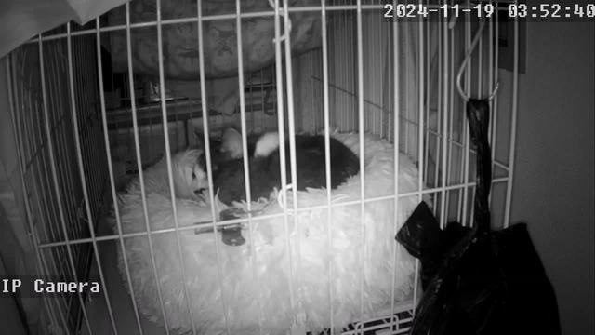

Japan
Kawasaki
Notes:
Shodan.io Demo
(~60s)

Slide 24
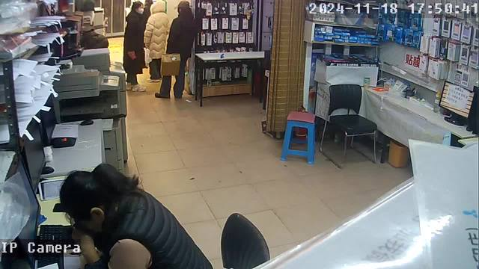

China
Shanghai
Notes:
Shodan.io Demo
(~60s)

Slide 25
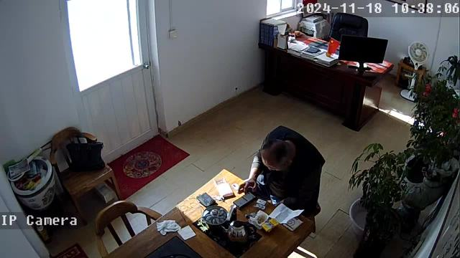
China
Qingdao
Notes:
Shodan.io Demo
(~60s)

Slide 26
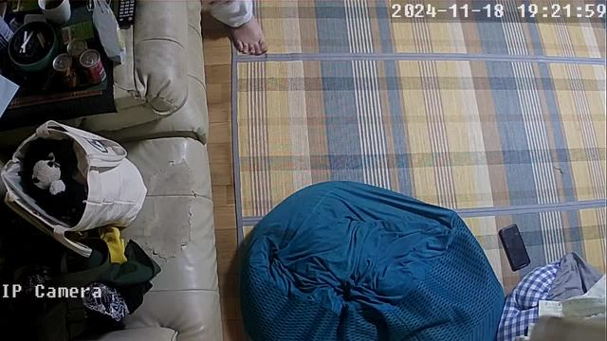
Japan
Kumamoto
Notes:
Shodan.io Demo
(~60s)

Slide 27
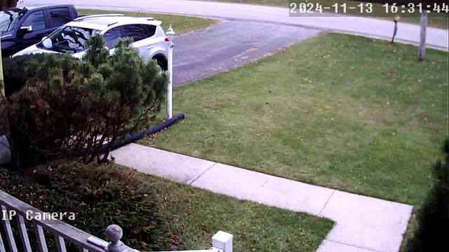

United States
Ashland, OH
Notes:
Shodan.io Demo
(~60s)

Slide 28
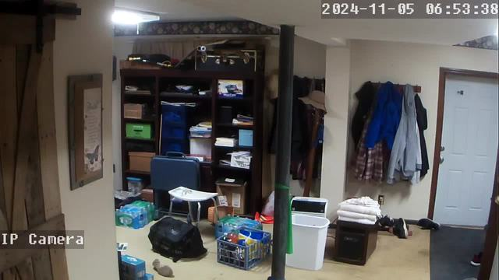
United States
North Canton, OH
Notes:
Shodan.io Demo
(~60s)

Slide 29
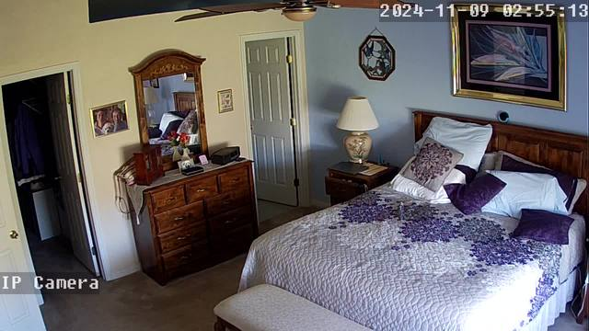
United States
Hamilton, OH
Notes:
Shodan.io Demo
(~60s)

Slide 30
Citations
Articles:
[1] Gillis, Alexander S., et al. “What Are IOT Devices?: Definition from TechTarget.” Search IoT, TechTarget, 21 Aug. 2023, www.techtarget.com/iotagenda/definition/IoT-device.
[2] “How the Internet of Things (IOT) Became a Dark Web Target – and What to Do about It.” World Economic Forum, www.weforum.org/stories/2024/05/internet-of-things-dark-web-strategy-supply-value-chain/. Accessed 18 Nov. 2024.
[3] Martin, James. “How Many Cyber Attacks Occur Each Day? (2024).” Exploding Topics, Exploding Topics, 30 Sept. 2024, explodingtopics.com/blog/cybersecurity-stats.
Images:
[4] “Owlet CAM® 2.” Owlet US, owletcare.com/products/owlet-cam-2. Accessed 18 Nov. 2024.
[5] Amazon.Com : Galayou Indoor Security Camera 2K, www.amazon.com/Indoor-Security-Galayou-Storage-Assistant/dp/ B0B1T8T1WD. Accessed 18 Nov. 2024.
[6] Amazon.Com : Outdoor 5G Light Bulb Home Security Camera, www.amazon.com/High-Brain-Camera-Wireless-Security/dp/B09PVD729J. Accessed 18 Nov. 2024.
* All RTSP camera images (slides 19-29) came from shodan.io searches
Template:
This presentation template was created by Slidesgo.

